Slide 1
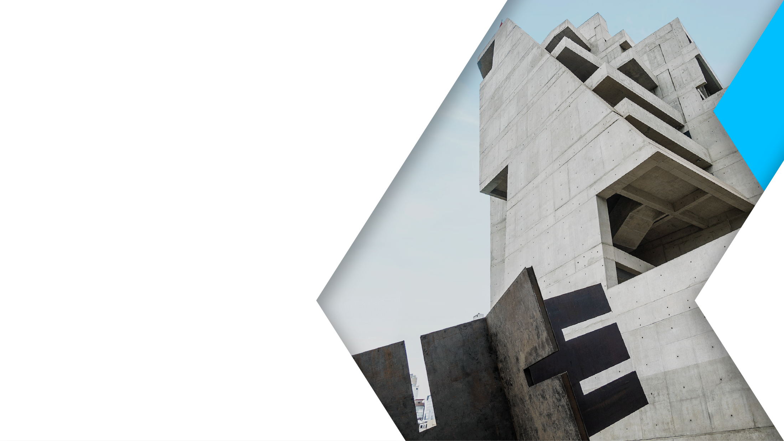


S4 – PFC1
19 / 04 / 2023

Slide 2

CS4002 - PFC1
Semantic segmentation
Fully Convolutional Networks for Semantic Segmentation
U-Net: Convolutional Networks for Biomedical Image Segmentation
The One Hundred Layers Tiramisu: Fully Convolutional DenseNets for Semantic Segmentation
Long et al.
Ronneberger et al.
Jegou et al.
2014
2015
2014
2015
2016
Semantic Image Segmentation with Deep Convolutional Nets and Fully Connected CRFs
SegNet: A Deep Convolutional Encoder-Decoder Architecture for Image Segmentation
Chen et al.
Badrinarayanan et al.
Notes:
https://www.v7labs.com/blog/image-segmentation-guide
Image Segmentation Algorithms Overview
https://arxiv.org/ftp/arxiv/papers/1707/1707.02051.pdf
A Survey of Semantic Segmentation
https://arxiv.org/pdf/1602.06541.pdf
Semantic Image Segmentation: Two Decades of Research
https://arxiv.org/pdf/2302.06378.pdf
Image Segmentation Using Deep Learning: A Survey https://arxiv.org/pdf/2001.05566.pdf
Random Forest with Learned Representations for Semantic Segmentation
https://arxiv.org/pdf/1901.07828.pdf
https://www.cse.iitk.ac.in/users/cs365/2012/submissions/rohanj/cs365/projects/report.pdf
https://www.microsoft.com/en-us/research/wp-content/uploads/2016/02/Criminisi_bmvc2008.pdf
======================================================
2006 - Conditional Random Fields (CRFs) based methods were introduced for semantic segmentation.
2012 - The DeepLab model was proposed by Chen et al., which employed a combination of convolutional neural networks (CNNs) and conditional random fields (CRFs) to achieve state-of-the-art results on the PASCAL VOC 2012 dataset.
2014 - Fully Convolutional Networks (FCN) were introduced by Long et al., which was a breakthrough in deep learning-based semantic segmentation. This method enabled end-to-end learning of segmentation tasks without the need for post-processing steps.
2015 - SegNet was introduced by Badrinarayanan et al., which was an encoder-decoder architecture that used max-pooling indices to perform upsampling.
2015 - U-Net was introduced by Ronneberger et al., which was a popular architecture for biomedical image segmentation. This architecture used skip connections to combine low-level and high-level features, improving segmentation accuracy.
2016 - Mask R-CNN was introduced by He et al., which extended the popular Faster R-CNN object detection architecture to perform instance segmentation.
2017 - RefineNet was introduced by Lin et al., which used multi-path refinement modules to combine features from different levels of a CNN.
2018 - DeepLabv3+ was proposed by Chen et al., which used atrous convolution, batch normalization, and improved skip connections to achieve state-of-the-art results on several datasets.
2019 - Dynamic Convolution was introduced by Zhu et al., which used dynamic kernels to learn adaptive spatial dependencies in feature maps, improving segmentation accuracy.
2020 - Vision Transformer (ViT) was proposed by Dosovitskiy et al., which achieved state-of-the-art results on several vision tasks, including semantic segmentation, by using self-attention mechanisms to capture global context.

Slide 3

CS4002 - PFC1
Contents
Paper 1: U-Net
Context
Network architecture
Convolution NN architecture
Notes:
Gradient Descent
Convolution
Pooling
Pixel-wise cross-entropy loss

Slide 4

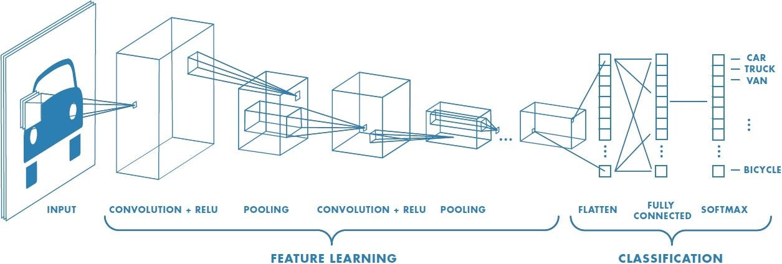

CS4002 - PFC1
Context
Le-Net-5
AlexNet
VGG
GoogleNet
Inception
ResNet
1998
2012
2014
2014
2015
Notes:
The typical use of convolutional networks is on classification tasks, where the output to an image is a single class label

Slide 5
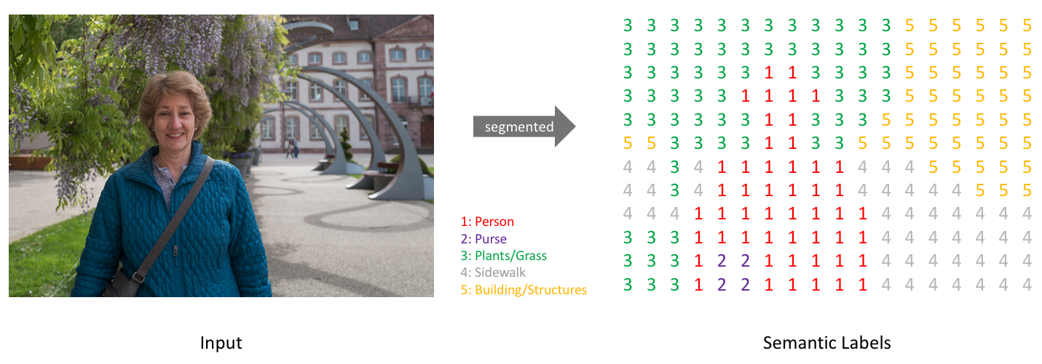

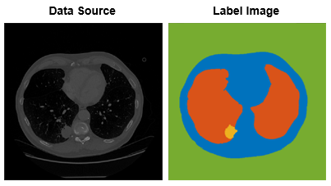
CS4002 - PFC1
Context
Notes:
However, in many visual tasks, especially in biomedical image processing, the desired output should include localization, i.e., a class label is supposed to be assigned to each pixel.

Slide 6
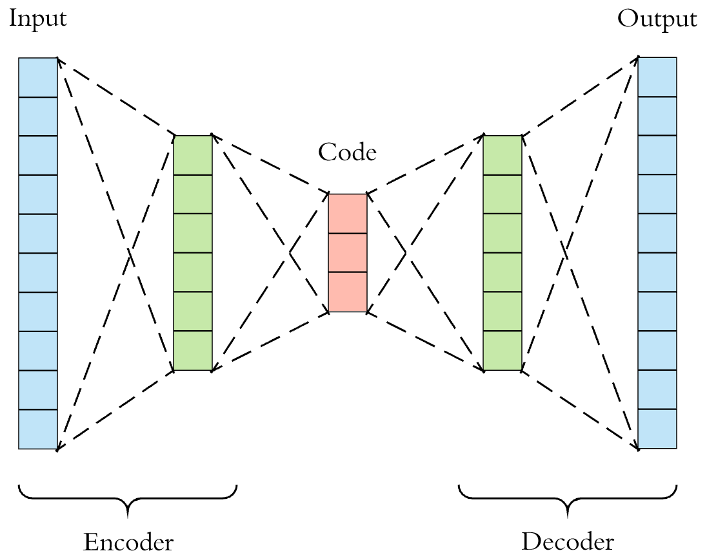
CS4002 - PFC1
Network architecture
The architecture consists of a contracting path (left side) and a symmetric expansive path (right side).
The contracting path capture context.
The expanding path enables precise localization.

Slide 7

CS4002 - PFC1
CONTRACTING PATH
EXPANSIVE PATH
Notes:
Increase the “What”
Reduce the “Where”
Create high-resolution segmentation map

Slide 8
CS4002 - PFC1
Notes:
Due to the unpadded convolutions, the output image is smaller than the input

Slide 9
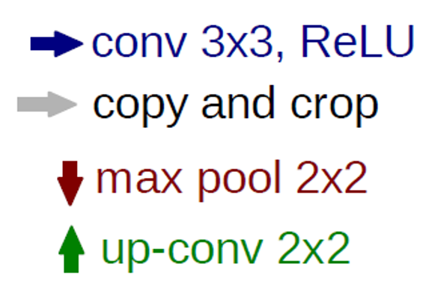
CS4002 - PFC1
C (# channels)
2C
2C
4C
2C
2C
Encoder building block
Decoder building block

Slide 10

CS4002 - PFC1
Convolution
Kernel
INSPIRATION: How to extract features with location information?
INPUT: image or batch
OUTPUT: new channel/feature map
CONSIDERATIONS:
Kernel values are learned through backpropagation.
Convolution operation forms many-to-one relationship.
Convolution is invariant to translation
class torch.nn.Conv2d(
in_channels,
out_channels,
kernel_size,
stride,
padding
)
Image
Notes:
Kernel concept
Matriz de pesos que se deliza sobre la entrada de la capa convolucional
Conjunto de pesos que se utilizan para detectar patrones especificos en la entrada.
Element-wise multiplication between the input matrix and the kernel matrix.
A convolution operation forms a many-to-one relationship.
Dependiendo del kernel ciertos pixeles se van a estimular, y otros se van a inhibir

Slide 11
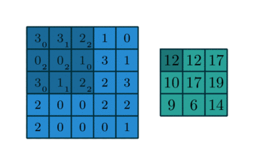
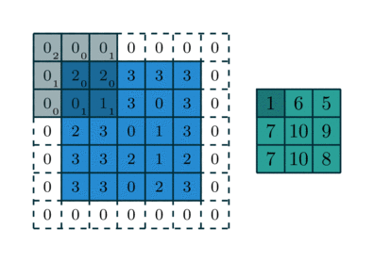
CS4002 - PFC1
torch.nn.Conv2d(
in_channels=1,
out_channels=1,
kernel_size=(3,3),
stride=1,
padding=“valid”
)
torch.nn.Conv2d(
in_channels=1,
out_channels=1,
kernel_size=(3,3),
stride=1,
padding=“same”
)
without padding
with padding
[(L − K + 2P)/S] + 1
L = Width or Height
Notes:
what is the difference between padding valid and padding same in PyTorch?

Slide 12

CS4002 - PFC1
torch.nn.Conv2d(
in_channels=3,
out_channels=1,
kernel_size=(3,3),
stride=1
)

Slide 13
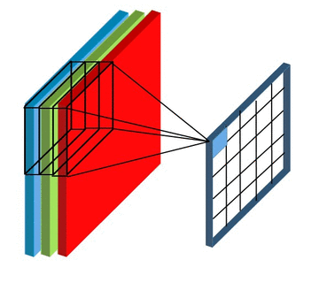
CS4002 - PFC1
torch.nn.Conv2d(
in_channels=3,
out_channels=1,
kernel_size=(3,3),
stride=1
)

Slide 14
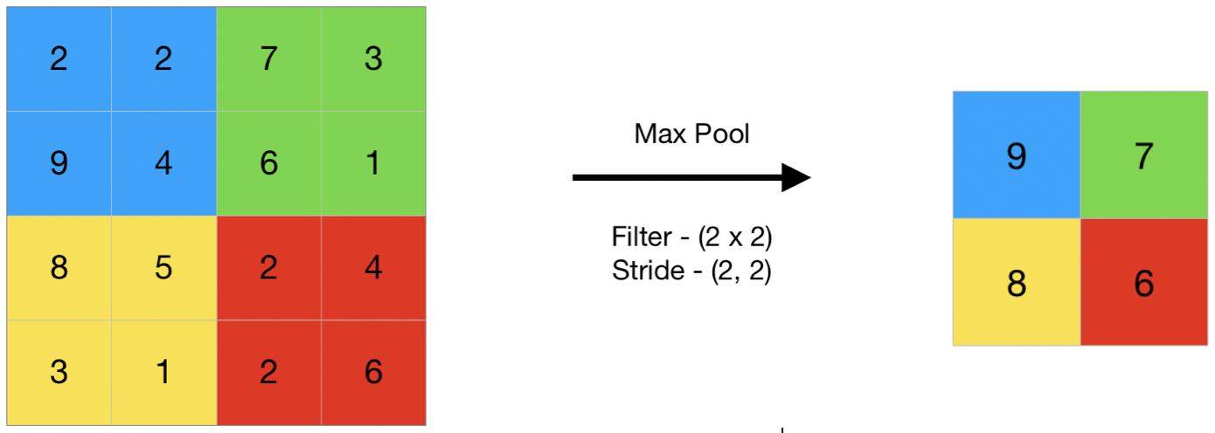
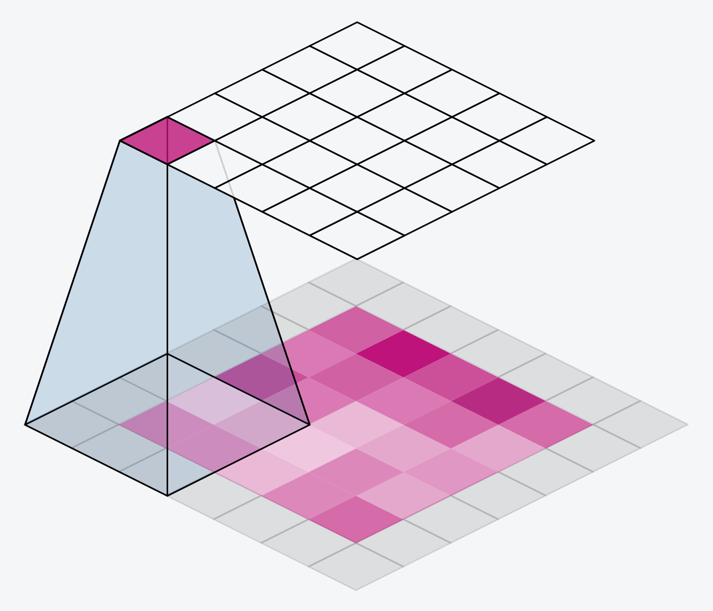
CS4002 - PFC1
Pooling
C (# channels)
2C
2C
Encoder building block
Notes:
Max Pooling

Slide 15
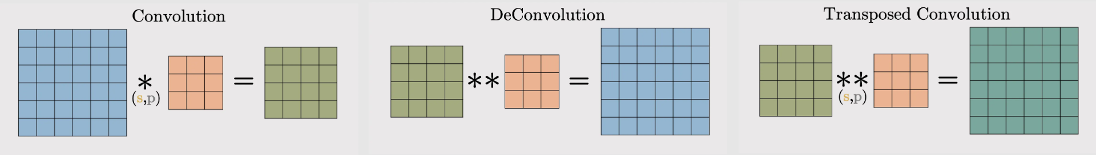
CS4002 - PFC1
Upconvolution
4C
2C
2C
Decoder building block
Notes:
Up Convolution
Reverses the operation of a standard convolutional layer
A transposed convolutional layer, on the other hand, is usually carried out for upsampling i.e. to generate an output feature map that has a spatial dimension greater than that of the input feature map.
https://towardsdatascience.com/what-is-transposed-convolutional-layer-40e5e6e31c11

Slide 16



CS4002 - PFC1
Upconvolution/Transposed convolution
Notes:
Up Convolution
Reverses the operation of a standard convolutional layer
A transposed convolutional layer, on the other hand, is usually carried out for upsampling i.e. to generate an output feature map that has a spatial dimension greater than that of the input feature map.
https://datascience.stackexchange.com/questions/6107/what-are-deconvolutional-layers
https://arxiv.org/pdf/1603.07285v1.pdf
https://towardsdatascience.com/what-is-transposed-convolutional-layer-40e5e6e31c11
https://arxiv.org/pdf/1603.07285.pdf
https://github.com/vdumoulin/conv_arithmetic/blob/master/README.md
https://www.matthewzeiler.com/mattzeiler/deconvolutionalnetworks.pdf
https://medium.com/geekculture/deconvolution-and-how-it-works-and-its-importance-80ce8f137e1b
https://towardsdatascience.com/types-of-convolutions-in-deep-learning-717013397f4d
https://medium.com/@marsxiang/convolutions-transposed-and-deconvolution-6430c358a5b6

Slide 17
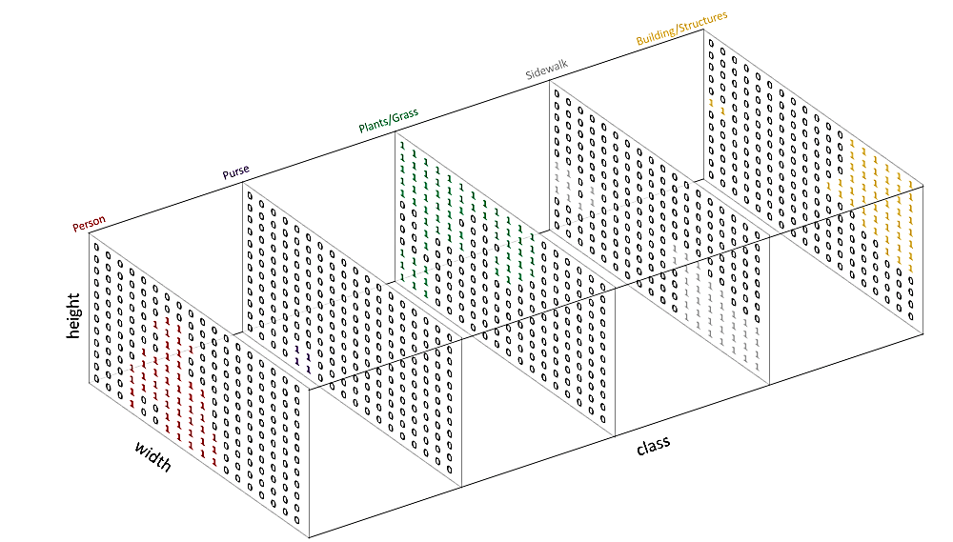
CS4002 - PFC1
Output
Notes:
Pixel-wise soft-max over the final feature map combined with the cross entropy loss function.

Slide 18
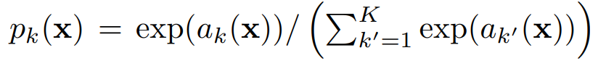
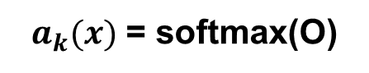

CS4002 - PFC1
Output
Output
pixel-wise soft-max
output O
$a_{k}(x)$ = softmax(O)
$$K$$
feature maps
1
0.0320586
x
x
2
0.08714432
x
x
3
0.23688282
4
0.64391426
the output is a probability
Notes:
Pixel-wise soft-max over the final feature map combined with the cross entropy loss function.
where l : Ω → {1, . . . , K} is the true label of each pixel and w : Ω → R is a weight map that we introduced to give some pixels more importance in the training.
https://stackoverflow.com/questions/17187507/why-use-softmax-as-opposed-to-standard-normalization
a_k(x) denotes the activation in feature channel k at the pixel position x

Slide 19
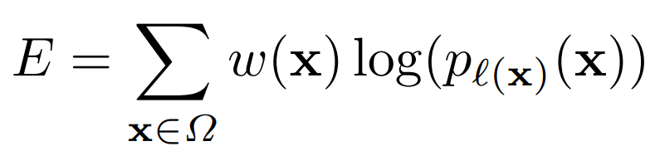

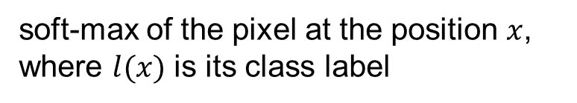
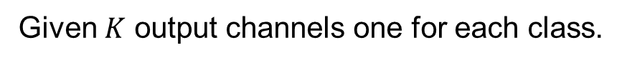
CS4002 - PFC1
Loss function
cross-entropy of the output
Given $K$ output channels one for each class.
soft-max of the pixel at the position $x$, where $l(x)$ is its class label
Notes:
Pixel-wise soft-max over the final feature map combined with the cross entropy loss function.
where l : Ω → {1, . . . , K} is the true label of each pixel and w : Ω → R is a weight map that we introduced to give some pixels more importance in the training.
cross entropy

Slide 20
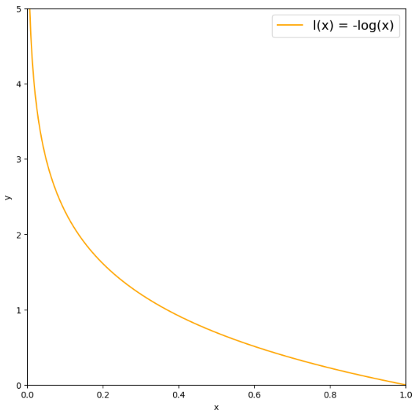
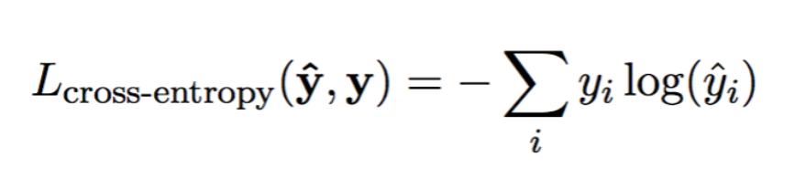
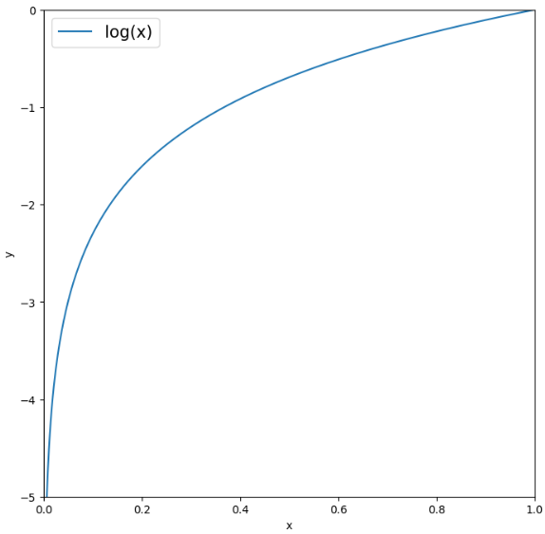
CS4002 - PFC1
Notes:
https://arxiv.org/pdf/1505.04597.pdf
https://machinelearningmastery.com/cross-entropy-for-machine-learning/
https://machinelearningmastery.com/softmax-activation-function-with-python/
https://www.v7labs.com/blog/semantic-segmentation-guide

Slide 21
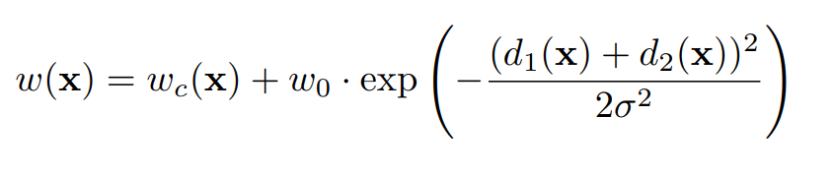
CS4002 - PFC1
Loss function
is a precomputed matrix
GOALS:
compensate the different frequency of pixels from a certain class
force the network to learn the small separation borders
CONSIDERATIONS:
the calculation is inspired by the particular dataset
Notes:
where l : Ω → {1, . . . , K} is the true label of each pixel and w : Ω → R is a weight map that we introduced to give some pixels more importance in the training.

Slide 22

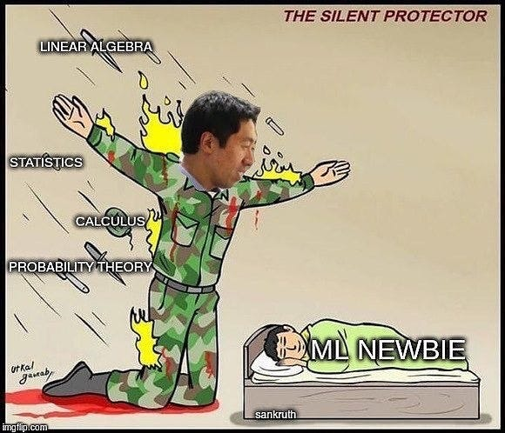
Gracias
Notes:
IDEAS:
Explain two building blocks of U-Net
Explain convolution, pooling and contrary operations
Study loss functions
Read second paper "Fully Convolutional Networks for Semantic Segmentation"

Slide 23
C (# channels)
2C
2C
4C
2C
2C
copy & crop
Encoder building block
Decoder building block

Slide 24
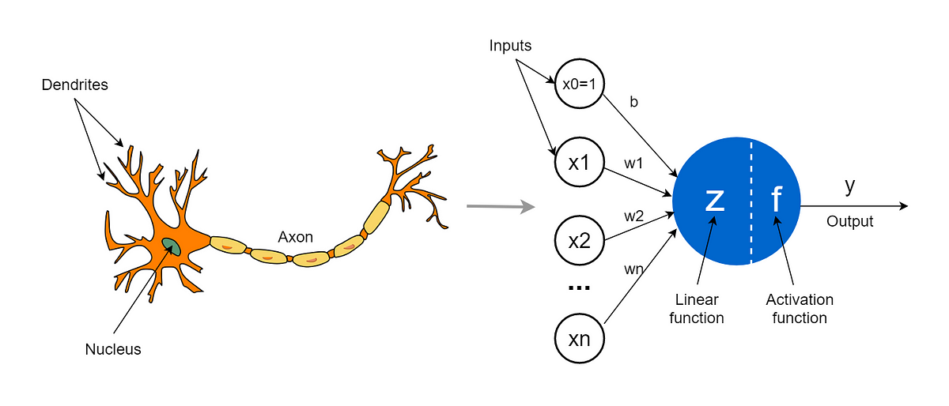
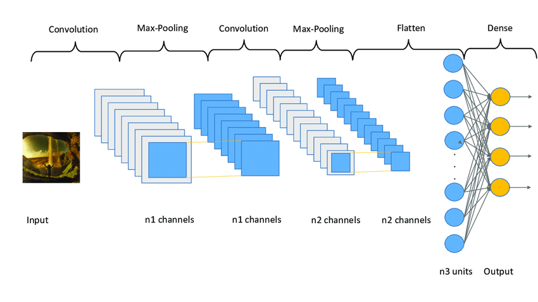
CS4002 - PFC1
Key concepts
ML Algorithms
CRF
Random Forests
GMM
Neural network basic concepts
Linear Regression (perceptron)
Forward/ Back Propagation
Deep Learning Architectures
Autoencoders
Convolutional Neural Networks
CNN
Convolution (deconvolution)
Pooling (unpooling)
Notes:
Images prompts:
perceptron vs. neural network
convolutional neural network
ML Algorithms
Random Forests
GMM

Slide 25




CS4002 - PFC1
Datasets
VOC (Visual Object Classes Challenge)
BDD100K
Notes:
https://synscapes.on.liu.se/download.html (337GB)
https://host.robots.ox.ac.uk/pascal/VOC/voc2012/#history
https://www.kaggle.com/datasets/pablocumbrera/pascal-voc-2011-include-hands-foot-head
https://www.kaggle.com/datasets/huanghanchina/pascal-voc-2012
https://www.kaggle.com/datasets/solesensei/solesensei_bdd100k
https://www.kaggle.com/datasets/santurini/semantic-segmentation-drone-dataset
https://www.kaggle.com/datasets/xiaose/cityscapes

Slide 26
CS4002 - PFC1
Bibliografía
http://vision.stanford.edu/teaching/cs131_fall1718/files/cs131-class-notes.pdf
https://www.v7labs.com/blog/image-segmentation-guide
https://arxiv.org/pdf/2302.06378.pdf
https://www.jeremyjordan.me/semantic-segmentation/

Slide 27
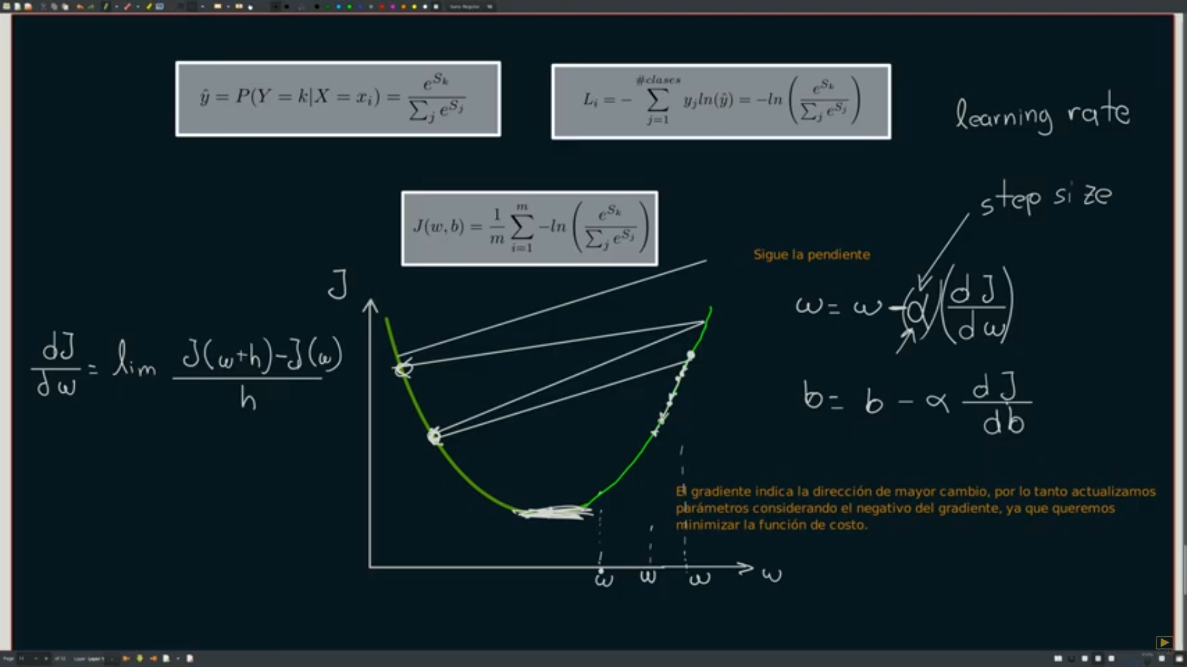
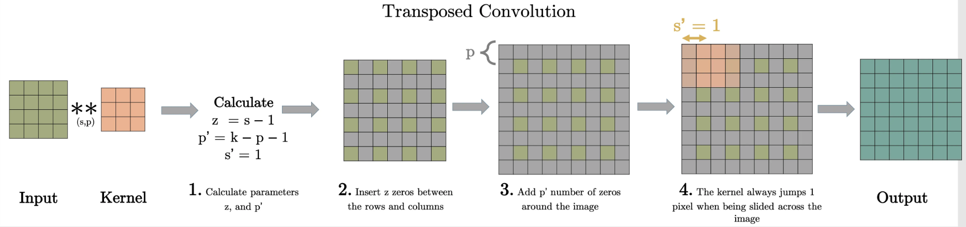
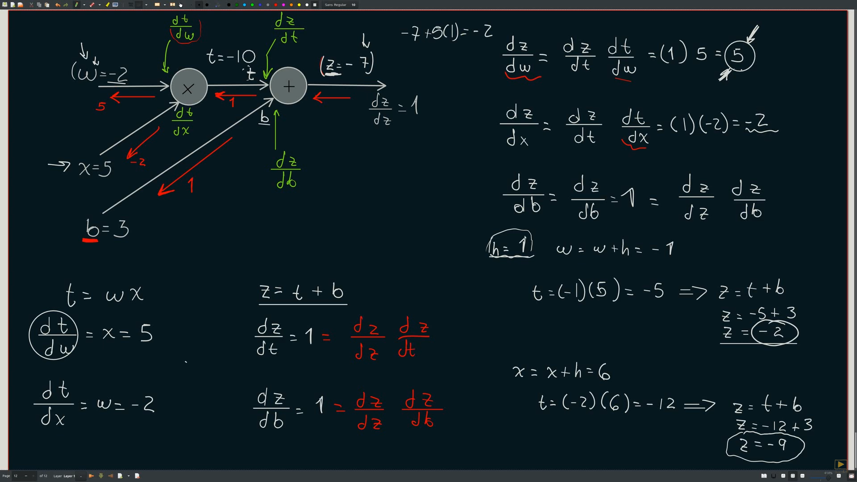
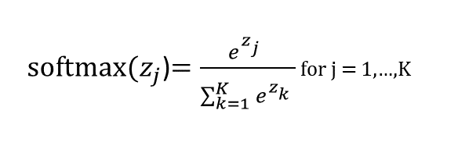
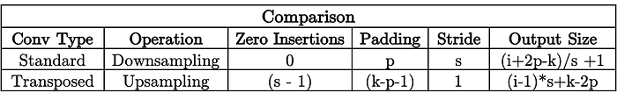

Slide 28
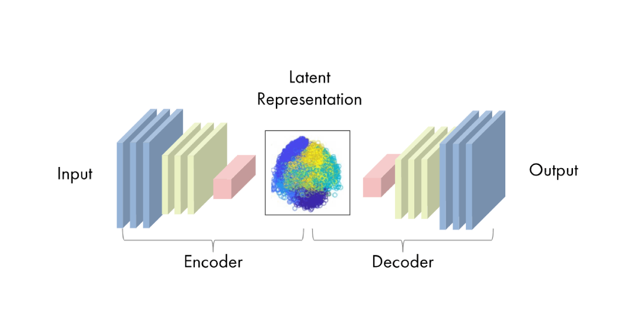
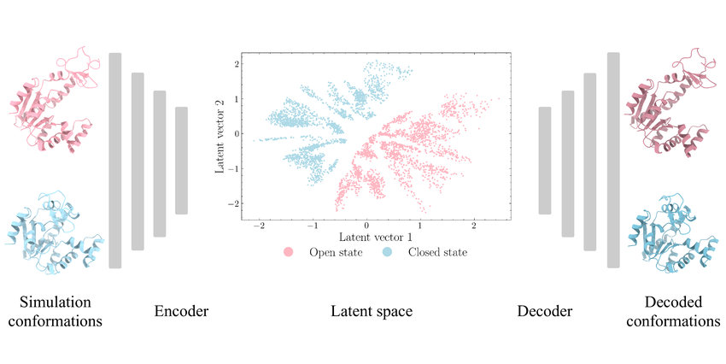
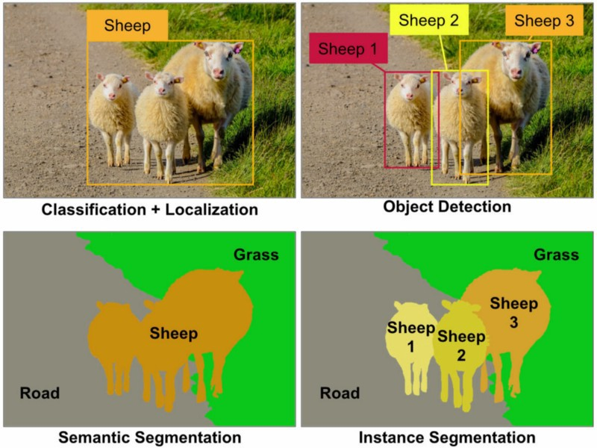
CS4002 - PFC1

Slide 29
CS4002 - PFC1
Inserta imagen aquí
Inserta texto de imagen aquí

Slide 30
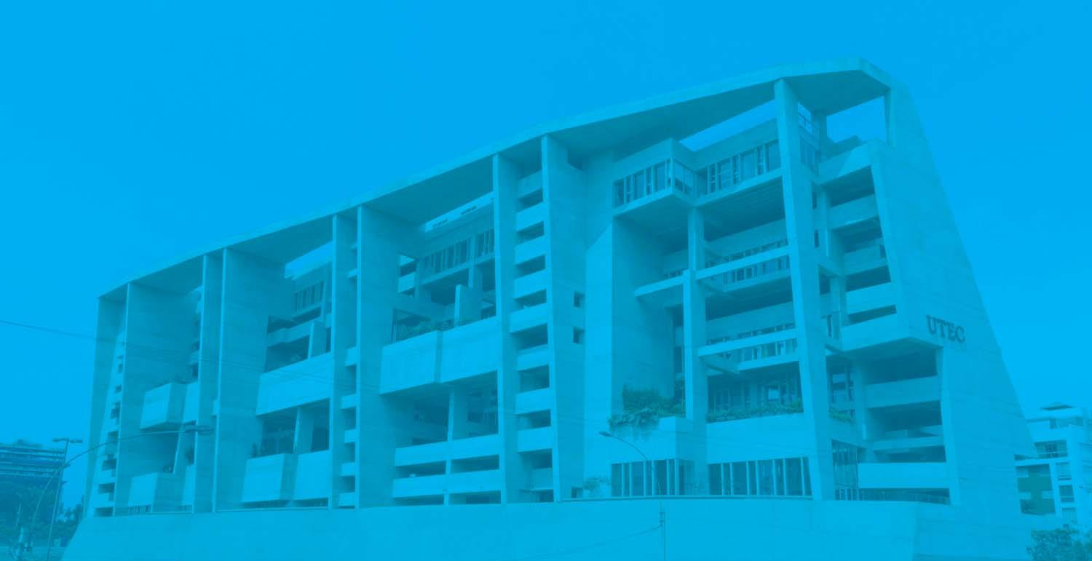
CS4002 - PFC1
1
INSERTA TÍTULO DEL TEMA AQUÍ

Slide 31
CS4002 - PFC1
Inserta imagen aquí
Inserta imagen aquí
Inserta imagen aquí
Inserta texto aquí
Inserta texto aquí
Inserta texto aquí
1
2
3

Slide 32
CS4002 - PFC1
Inserta imagen aquí
Inserta texto aquí
Inserta imagen aquí
Inserta texto aquí
Inserta imagen aquí
Inserta texto aquí

Slide 33
Nombre del curso
Nombre del docente
Inserta título aquí
Inserta texto aquí
Inserta texto aquí
Inserta texto aquí
Inserta texto aquí
A
B
C

Slide 34
Nombre del curso
Nombre del docente
Inserta título aquí
Insertar imagen aquí
Insertar imagen aquí
Insertar imagen aquí
Insertar imagen aquí
Insertar imagen aquí
Inserta texto aquí
Inserta texto aquí
Inserta texto aquí
Inserta texto aquí
Inserta texto aquí
Insertar imagen aquí
Insertar imagen aquí
Insertar imagen aquí
Insertar imagen aquí
Insertar imagen aquí
Inserta texto aquí
Inserta texto aquí
Inserta texto aquí
Inserta texto aquí
Inserta texto aquí

Slide 35
Nombre del curso
Nombre del docente
Insertar imagen aquí
Insertar imagen aquí
Insertar imagen aquí
Insertar imagen aquí
Insertar imagen aquí
Inserta texto aquí
Inserta texto aquí
Inserta texto aquí
Inserta texto aquí
Inserta texto aquí
Inserta título aquí
Insertar imagen aquí
Insertar imagen aquí
Insertar imagen aquí
Insertar imagen aquí
Insertar imagen aquí
Inserta texto aquí
Inserta texto aquí
Inserta texto aquí
Inserta texto aquí
Inserta texto aquí

Slide 36
Nombre del curso
Nombre del docente
Inserta título de matriz de ciclo aquí

Slide 37
Nombre del curso
Nombre del docente
Inserta título de objetivo básico aquí

Slide 38
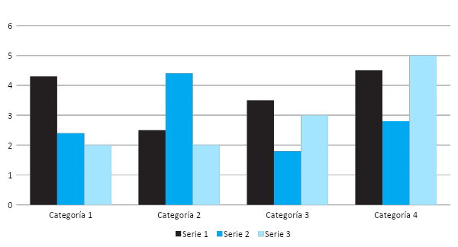
Nombre del curso
Nombre del docente
Inserta título de gráfico de columna agrupada aquí

Slide 39
Nombre del curso
Nombre del docente
Inserta título de tabla aquí

Slide 40
Nombre del curso
Nombre del docente
Inserta imagen aquí
Inserta imagen aquí
Inserta imagen aquí
Inserta título aquí
Inserta texto aquí
Inserta texto aquí
Inserta texto aquí
Inserta texto aquí

Slide 41

Inserta título aquí
Inserta imagen aquí
Inserta imagen aquí
Inserta texto aquí
Inserta imagen aquí
Inserta texto aquí
Inserta imagen aquí
Inserta texto aquí
Inserta imagen aquí
Inserta texto aquí
Inserta texto aquí

